Slide 1
EC544 Challenge 3
Group Members: Boheng Zhao, Huichong Fu,
Nirmit Shah,Yi Zhu

Slide 2
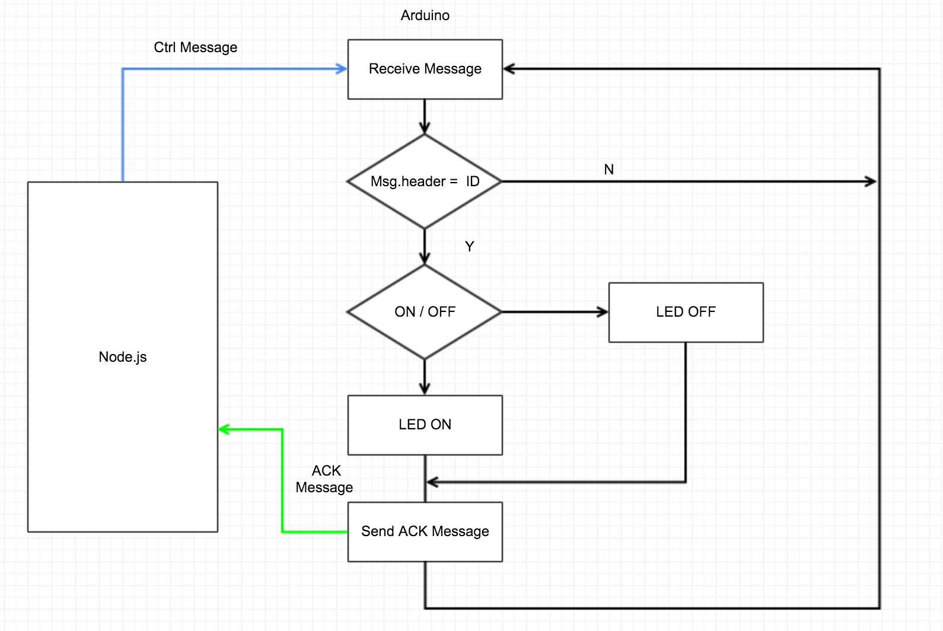
Summarizing Design

Slide 3
Architecture/Data Flow
Data will be transmitted between 4 router XBees and the coordinator XBee to control the LED’s on and off by the server running by node express.
By clicking the buttons on the website, the sever will send a on or off request to the router XBee by node.js. After the LED is set to on/off, the router XBee will send a confirmation massage to the server to change the text of the button.ß

Slide 4
Demonstration

Slide 5
Thank You !

